Slide 1
West High School
International Baccalaureate

Slide 2
IB: World Class College Preparation
Research
Critical Thinking
Communication
Reflection
Opportunities to grow and become leaders

Slide 3
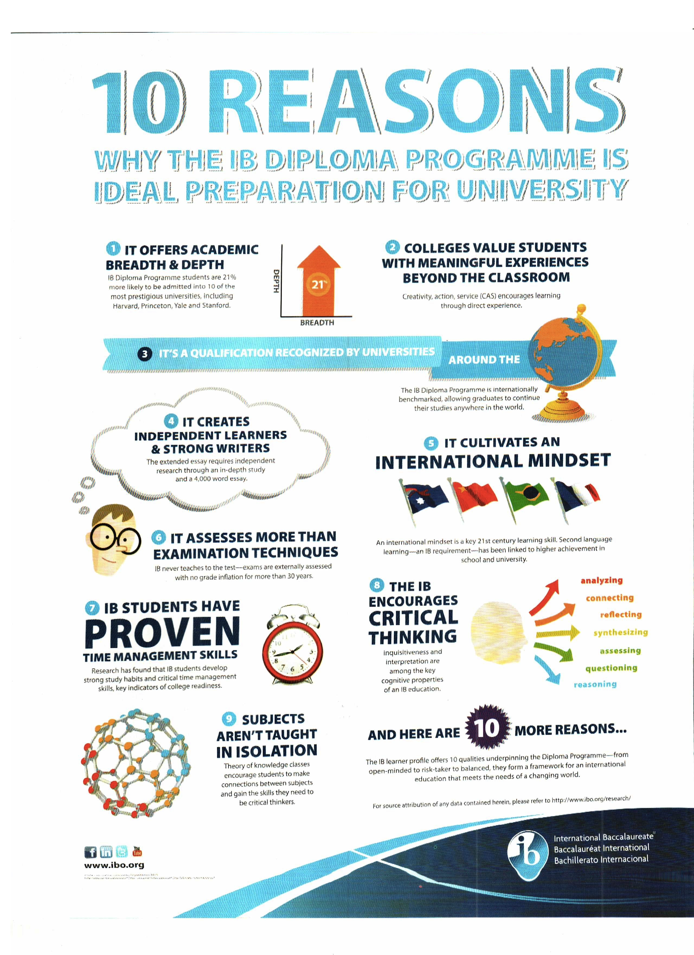
West High IB
Academically challenging
Recognized and respected by colleges and universities as the most rigorous program offered to high school students worldwide.
Participating in IB increases the chances of attending college and graduating on time

Slide 4
WHAT DOES IB DO FOR OUR KIDS?
1676 Colleges and Universities in the US now have official policies for admitting IB students.
UTK IB Credits
School | Overall Acceptance | IB Acceptance | IB Diploma Acceptance
UGA | 65.0% | 93.5% | 94.3%
UNC Chapel Hill | 35.0% | 57.6% | 63.6%
Clemson | 52.0% | 84.7% | 93.2%
Harvard | 11.0% | 12.2% | 12.1%

Slide 5
Notes:
Inquirers: curious, enthusiastic life-long learners; knowledgeable: exploring significant ideas locally and globally; Thinkers: critical, ethical, creative decision makers; Communicators: good listeners, confident in more than one language; Principled: Honest, fair and responsible; Open-Minded: developing critical appreciation of our own cultures and the cultures of others; Caring: committed to service with the community; Risk-takers: creative, resourceful and resilient; Balanced: focused on well-being of ourselves and those around us; reflective: thoughtful, realistic and hopeful for the future.
----- Meeting Notes (9/17/15 11:34) -----
----- Meeting Notes (9/17/15 11:36) -----
----- Meeting Notes (9/17/15 11:42) -----
Open-Minded: developing critical appreciation of our own cultures and the cultures of others; Caring: committed to service with the community; Risk-takers: creative, resourceful and resilient; Balanced: focused on well-being of ourselves and those around us; reflective: thoughtful, realistic and hopeful for the future.

Slide 6
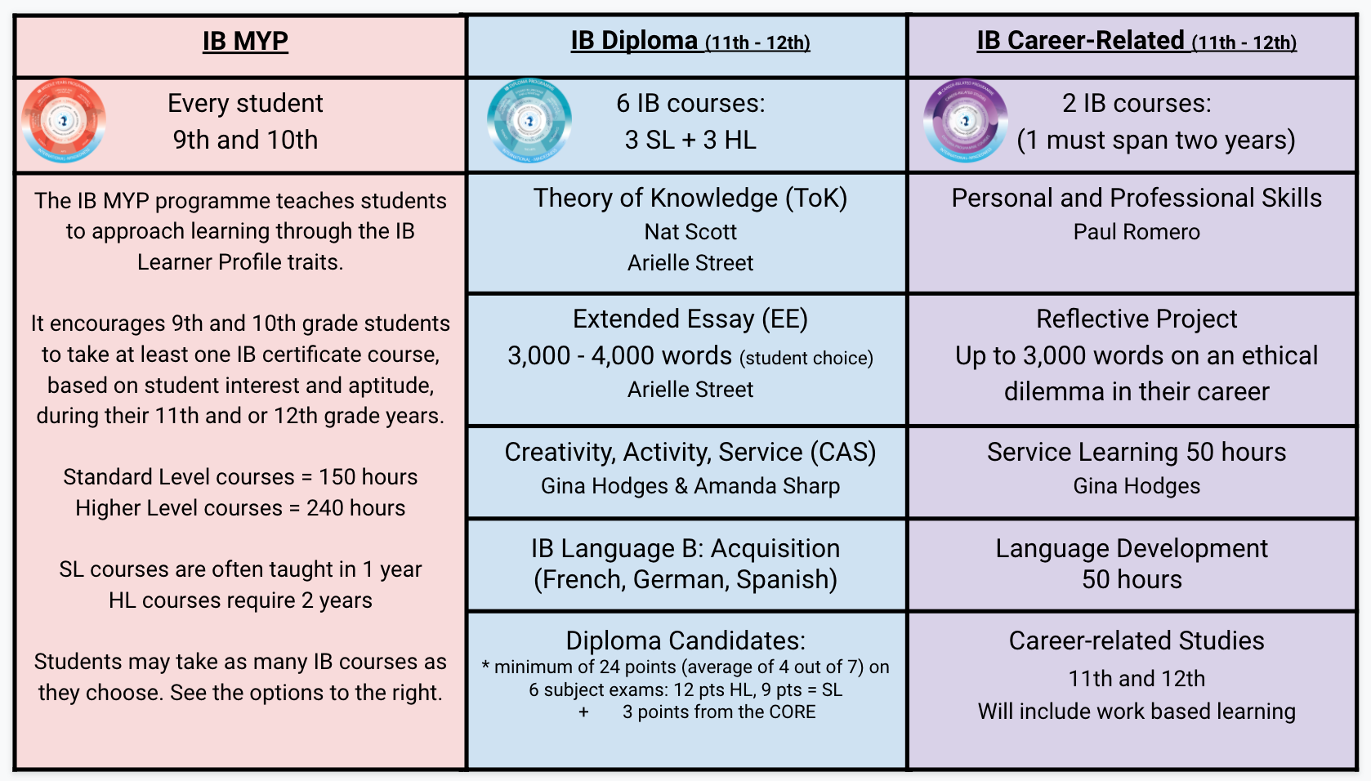
Three unique IB programs

Slide 7
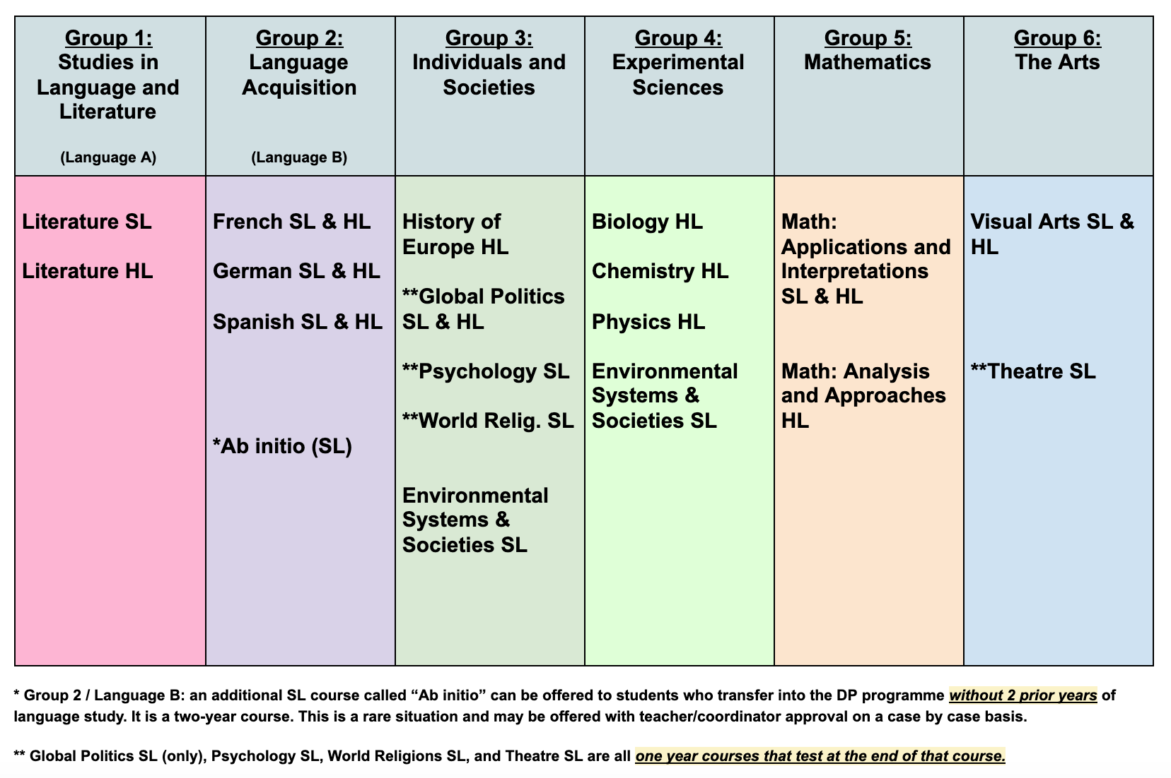
IB Courses Offered

Slide 8
IB Career-Related Programme
IB Career Paths, sign up as 9th graders
Health Science
Nutrition and Dietetics
Coding
Engineering

Slide 9
Why West? Why IB?
Outstanding preparation for college/university
Emphasis on critical thinking, writing, analysis, oral presentation
Camaraderie among IB students
IB students “stand out” in the college admission process
West is a fun place to be!

Slide 10
Who to Contact for More Information
Valerie Schmidt-Gardner
IB Programme Coordinator
valerie.schmidtgardner@knoxschools.org
Lisa Roberts
9th grade School Counselor
lisa.roberts@knoxschools.org

Slide 11
IB Information Night
Tuesday, Feb, 15
6:00 - 7:30
WHS Mini-Auditorium

Slide 12
Transfers
Transfer applications are now available.
Apply for a transfer.
We will contact you to set up screening.
The Transfer Window closes at 4pm
Tuesday, February 22, 2022.
For more information, contact the
KCS Transfer Office or click this link: https://www.knoxschools.org/Page/10664
Notes:
shadow days, tours

Slide 13
West High School International Baccalaureate

